Slide 1
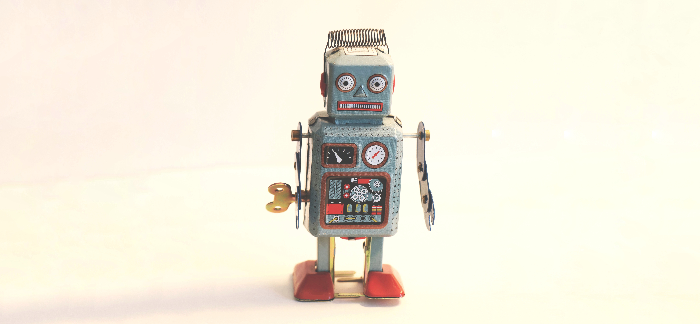
AI Is Broken
Sophie Searcy

Slide 2
AI Is Broken
slides at soph.info/ai-traps
Sophie Searcy

Slide 3
Caveats
AI
lumping together Data Science, Artificial Intelligence, Machine Learning, Data Mining, etc.
Audience
Conversant in AI topics.
Not necessarily experts or practitioners.
Notes:
Right now I teach data science in NYC
When teaching my students, our most used package is a self-professed Machine Learning package
I’m teaching the same algorithms I learned in Data Mining Artificial Intelligence Autonomous Robotics
(frankly) Cognitive Science

Slide 4
What is AI?
Notes:
2 minutes
I’m going to begin by sketching out what I mean by AI with a bit more precision.
The first ideas we’ll better define are models and learning

Slide 5
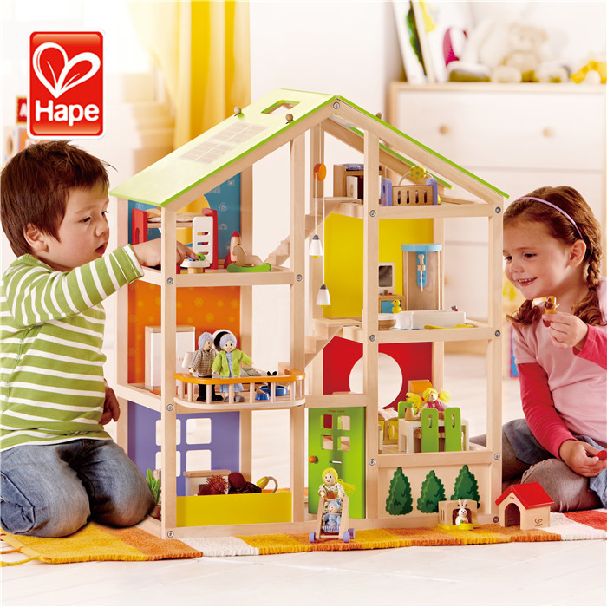
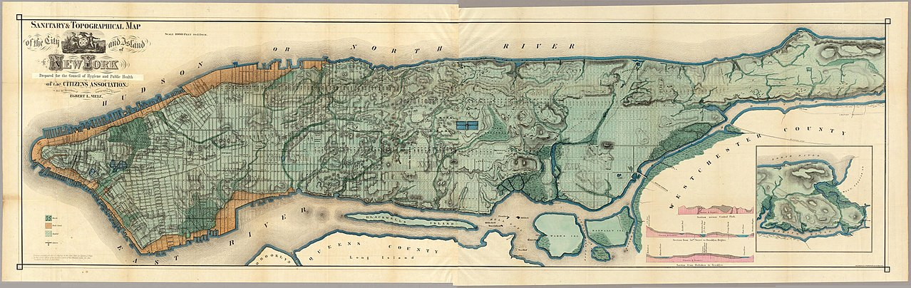
Model: a learning algorithm
A model is a small thing that captures a larger thing.
A good model omits unimportant details while retaining what’s important.

Slide 6
Model: a learning algorithm
Industry sometimes uses “algorithm” and “model” interchangeably.
Words are complicated (ask anyone who works in NLP)

Slide 7
Learn verb
\’lern\
to process past experience and update a model such that the the model is more useful for future experience
Notes:
It’s a lot of words. We’ll break it down

Slide 8
Learn verb
\’lern\
to process past experience and update a model such that the the model is useful for future experience
Notes:
Learning is forward looking.
Time is built in. We’ll come back to this point later

Slide 9
Learn verb
\’lern\
to process past experience and update a model such that the the model is useful for future experience
Notes:
I’m going to talk a lot about models today
The important thing here is that when something is learning, it’s making changes based on experience

Slide 10
Learn verb
\’lern\
to process past experience and update a model such that the the model is useful for future experience
Notes:
Again, time is important here

Slide 11
Model: a learning algorithm
Input Data
All models contain a prediction function
Prediction function
Prediction
Notes:
Here’s the boxology version
Models take input data and use a prediction function to generate an output.

Slide 12
Model: a learning algorithm
Input Data
Parameters
Determine model output
Learned from data
Prediction function
Parameters
Prediction
Notes:
A models parameters are the knobs that the model tunes as it learns to generate better output.

Slide 13
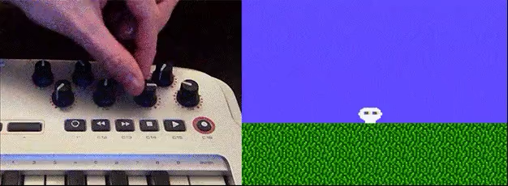
Model: a learning algorithm
Notes:
When a model is “learning” it’s looking at the input data
and then tweaking parameters until it gets the output that it wants.

Slide 14
Models are data hungry
Notes:
5 minutes
Okay, now we have a general framework for what a model does.
Now let’s move on to thinking about incentives

Slide 15
Models are data hungry
Models
Learn from a limited set of training data
Apply what was learned to production
“Production” is data science lingo for the entire world
Notes:
I said that time is very important when thinking about models
The crucial point here is that models are limited in what they get to learn from.
And in order to be useful, models must be applied to new data.
New data means surprises.

Slide 16
Models are data hungry
Models
Learn from a limited set of training data
Apply what was learned to production
“Production” is data science lingo for the entire world
One of the most difficult tasks in AI:
use training data (data you have) to judge how a model will perform in production (data you don’t have) .

Slide 17
Notes:
Consider object recognition.
Here are examples from the frog category of the CIFAR dataset.
The better a model gets at this task

Slide 18
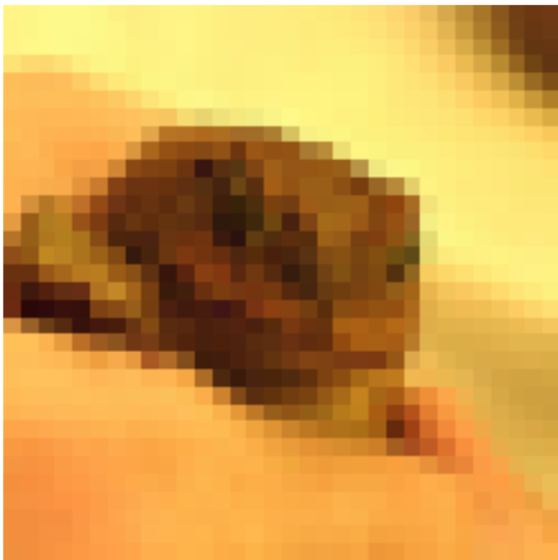
Notes:
Consider object recognition.
Here are examples from the frog category of the CIFAR dataset.
In order for a model to do this well, it must actually simulate the world.
In production, the model will see
frog species it has never seen before
in settings and lighting it’s never seen before
from angles it’s never seen before

Slide 19
Speed limits for data
Notes:
8 minutes
Okay, now we have a general framework for what a model does.
Now let’s move on to thinking about incentives

Slide 20
Speed limits for data
“Traditional” models (Support Vector Machines, Linear Models, Random Forests, K Nearest Neighbors)
Batch data: look at the entire dataset at once.
Training time increases with dataset size.

Slide 21
Speed limits for data
Data Set Size | Time to train
💾 | ⏲
💾💾
💾💾💾💾

Slide 22
Speed limits for data
Data Set Size | Time to train
💾 | ⏲
💾💾 | ⏲⏲⏲⏲
💾💾💾💾

Slide 23
Speed limits for data
Data Set Size | Time to train
💾 | ⏲
💾💾 | ⏲⏲⏲⏲
💾💾💾💾 | ⏲⏲⏲⏲⏲⏲⏲⏲⏲⏲⏲⏲⏲⏲⏲⏲⏲⏲⏲⏲⏲⏲⏲⏲

Slide 24
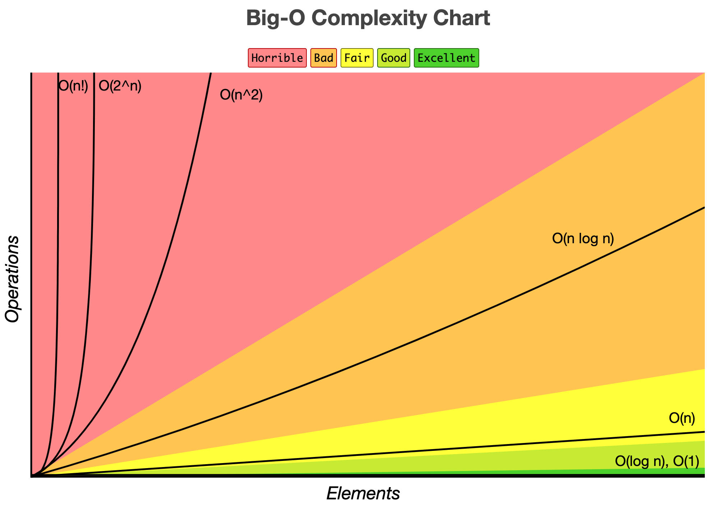
Eric Drowel et al.
Notes:
This looks at what computer scientists and data scientists call Big O. Big O notation is an approach that allows us to elegantly quantify how the resources an algorithm consumes change as the input to the algorithm grows.

Slide 25
Traditional
Approaches
Eric Drowel et al.
Notes:
This looks at what computer scientists and data scientists call Big O. Big O notation is an approach that allows us to elegantly quantify how the resources an algorithm consumes change as the input to the algorithm grows.

Slide 26
Modern AI removes the speed limit
Notes:
14 minutes
Okay, now we have a general framework for what a model does.
Now let’s move on to thinking about incentives

Slide 27
Enter Stochastic Gradient Descent
In the last two decades, AI has shifted to approaches that strongly incentivize large datasets
SGD powers Deep Learning models
Traditional AI models have been modified to take advantage of SGD

Slide 28
How does SGD work?
Gradient descent (not stochastic)
Put a number on your model’s performance. (Loss function)
Determine which direction decreases the loss function. (Find the Gradient).
Turn the knob in that direction. (Backpropagation)
(Wash, rinse, repeat for every parameter)

Slide 29
How does SGD work?
Stochastic Gradient Descent:
Use a small subset of your dataset to estimate the loss for the entire dataset (Minibatch)

Slide 30
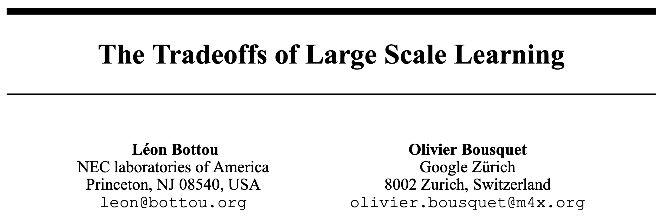
For SGD-based models, the amount of time it takes to fit a model does not depend on the size of the dataset.

Slide 31
Stochastic Gradient Descent
Data Set Size | Time to train
💾 | ⏲⏲⏲⏲
💾💾
💾💾💾💾

Slide 32
Stochastic Gradient Descent
Data Set Size | Time to train
💾 | ⏲⏲⏲⏲
💾💾 | ⏲⏲⏲⏲
💾💾💾💾

Slide 33
Stochastic Gradient Descent
Data Set Size | Time to train
💾 | ⏲⏲⏲⏲
💾💾 | ⏲⏲⏲⏲
💾💾💾💾 | ⏲⏲⏲⏲

Slide 34
Traditional
Approaches
SGD
Eric Drowel et al.
Notes:
This looks at what computer scientists and data scientists call Big O. Big O notation is an approach that allows us to elegantly quantify how the resources an algorithm consumes change as the input to the algorithm grows.

Slide 35
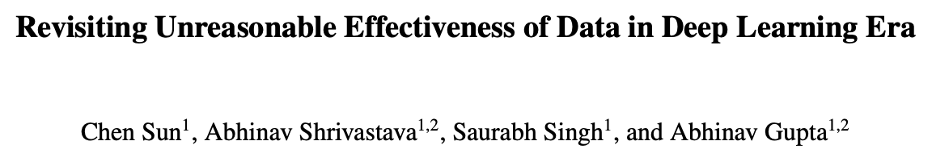
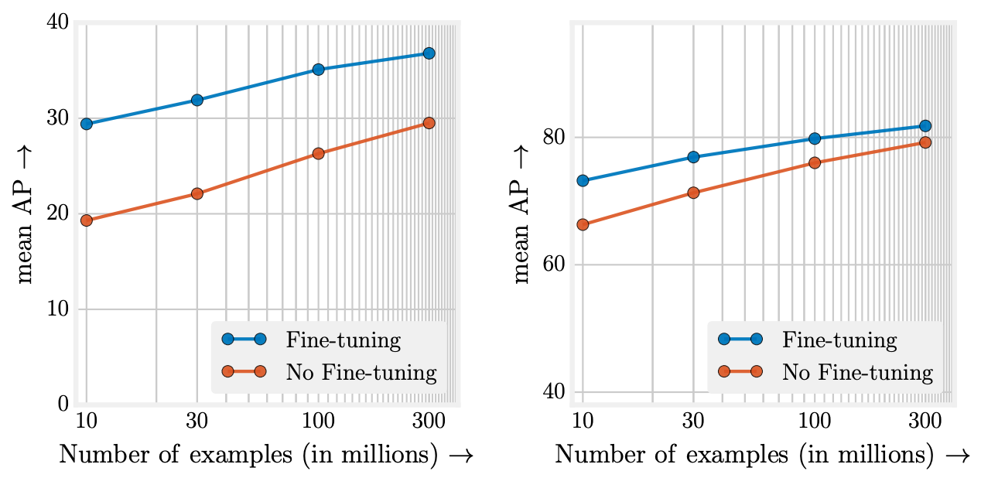

Slide 36
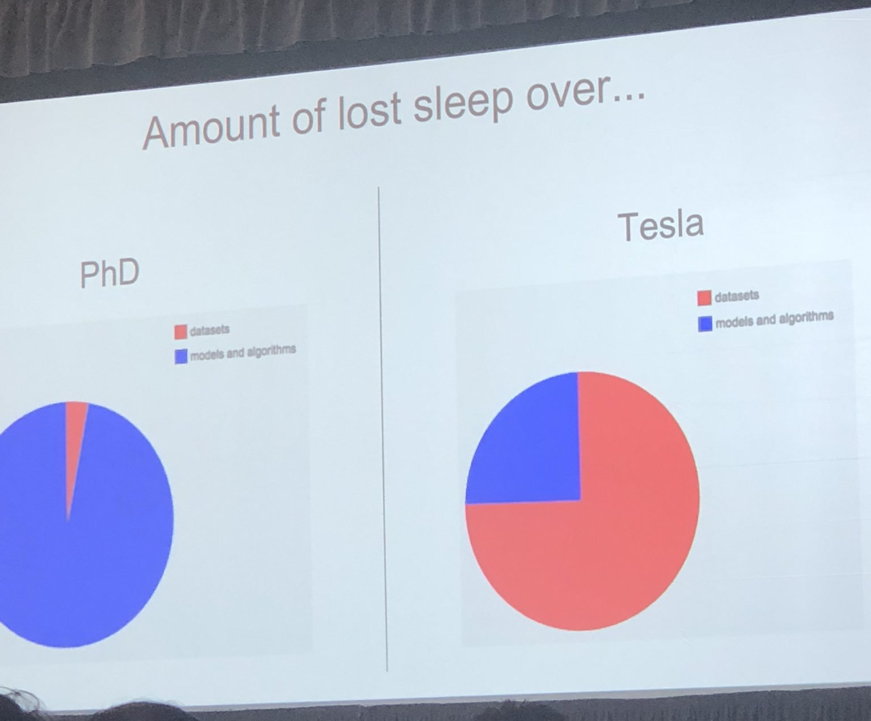
slide: Andrej Karpathy; photo: Lisha Li

Slide 37
Scale is bad
Notes:
19 minutes
Okay, now we have a general framework for what a model does.
Now let’s move on to thinking about incentives

Slide 38
Scale is bad
AI models either
Replace labor humans would do
Make new forms of labor possible
Both of these are most profitable at scale!

Slide 39
Scale is bad
Cathy O'Neil: “﻿the three elements of a WMD: Opacity, Scale, and Damage”

Slide 40
Scale is bad
For AI companies bigger means
Better performing models
Monopolies on data/content
Monopsonies on AI developers
Leverage over regulators

Slide 41
Scale is bad
For AI companies bigger means
Better performing models
Monopolies on data/content
Monopsonies on AI developers
Leverage over regulators
BAD!

Slide 42
Scale is bad
For AI companies bigger means
Better performing models
Monopolies on data/content
Monopsonies on AI developers
Leverage over regulators
These incentives have always been present. But now there’s no speed limit!
BAD!

Slide 43
What now?
Notes:
23 Minutes

Slide 44
What now?
There is a fundamental incentive for AI to scale
This will not be fixed by:
Technical advances
A more diverse industry
Quantifying or removing bias in models/datasets
Notes:
These incentives are baked in.

Slide 45
What now?
AI as an industry must be treated as one with inherent risk.
Regulation with teeth.
Professional accountability.
Default presumption of harm.
Examples
Medicine
Weapons
Notes:
These incentives are baked in.
They will not go away
They will not be “solved” by some technical advance
They will not be fixed if we make our industry more diverse

Slide 46
AI Is Broken
web: soph.info
github: @artificialsoph
twitter: @artificialsoph
Sophie Searcy

Slide 47
Image source
Tincho Franco
Rock'n Roll Monkey

